Slide 1
BT 601: Analytical Biotechnology
-Prof. Siddhartha Sankar Ghosh
Lec-12

Slide 2
Synthetic circuits integrating logic and memory in living cells

Slide 3
Circuit Design
AHL: N-Acyl homoserine lactone
aTc: Anhydrotetracycline

Slide 4
Figure 2. Recombinase-based logic gates can implement a complete set of two-input–one-output Boolean logic gates.

Slide 5
Gate operation for memory
Percentage of cells maintaining GFP expression, assayed by flow cytometry after gating by forward and side scatter, in cells containing an AND gate induced to the ON state after day 0 and continuously diluted and grown without input signals for 9 d thereafter.

Slide 6
Stable memory maintenance over multiple cell generations and after cell death

Slide 7
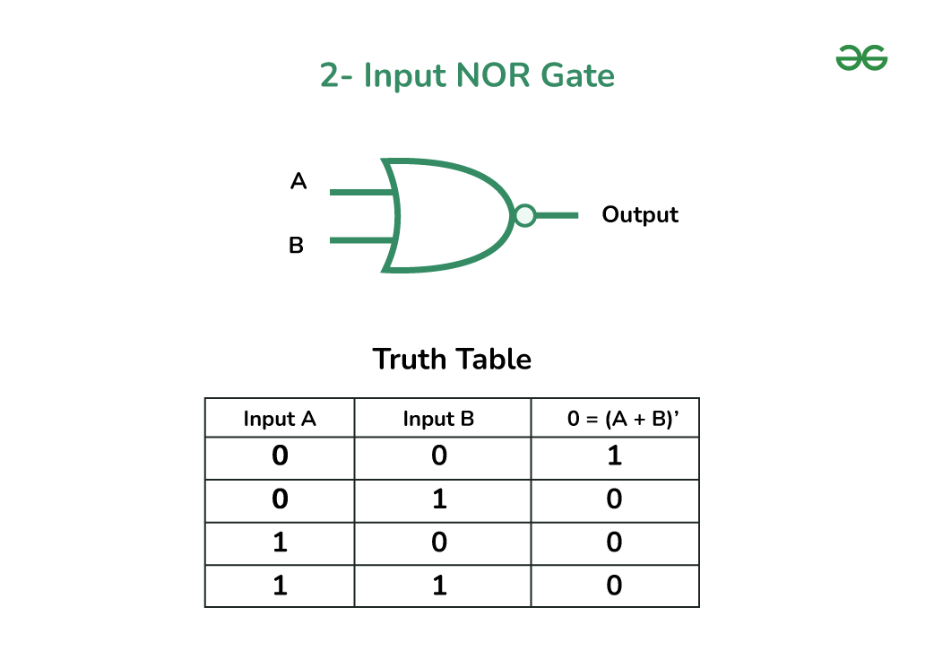
NOR Gate Operation
Each state of a NOR gate, as uniquely detected by PCR (yellow arrows indicate primers labeled as P1–P4) after cell death, and analysis of PCR products by electrophoresis on a 1% agarose gel.

Slide 8
Detection of NOR by PCR

Slide 9
Recombinase-based logic and memory can implement digital-to-analog converters
Cells were exposed to no inputs, AHL only, aTc only, or AHL and aTc simultaneously. (a–c) Various digital combinations of the input inducers result in multiple levels of analog gene expression outputs on the basis of the varying strengths of the promoters used and the sum of their respective outputs. Non-normalized mean expression levels are given to the right of each bar in arbitrary units (AU) of fluorescence, and normalized expression levels are listed in the column labeled OUT, where they are rounded to the nearest integer, and 1× corresponds to ~2,700 AU.
Fluorescence levels of the digital-to-analog converters with no inputs are very low on the basis of comparisons to control circuits that lack the gfp gene and cells that contain the gfp gene with an inverted promoter

Slide 10
Recombinase-based logic and memory can implement digital-to-analog converters

Slide 11
Computing in mammalian cells with nucleic acid strand exchange

Slide 12
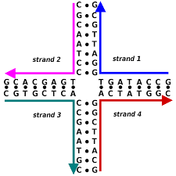
Four Point Junction of DNA

Slide 13
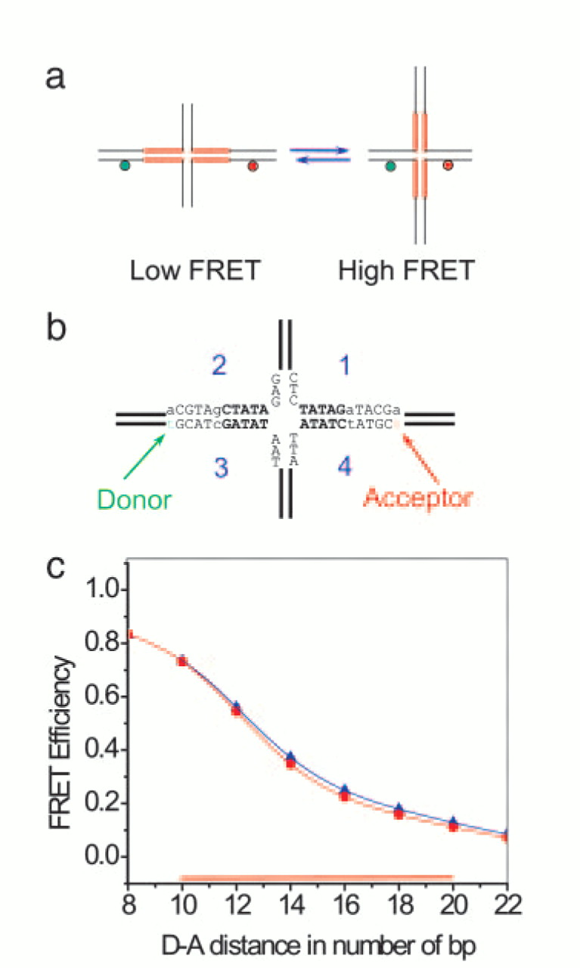
Low to High FRET

Slide 14
Summary:
DNA strand displacement has been widely used for the design of molecular circuits, motors, and sensors in cell-free settings.
Here, the scientists have adapted strand displacement and exchange reactions to mammalian cells and report DNA circuitry that can directly interact with a native mRNA.
They began by optimizing the cellular performance of fluorescent reporters based on four-way strand exchange reactions and identified robust design principles by systematically varying the molecular structure, chemistry and delivery method.
Next, they developed and tested AND and OR logic gates based on four-way strand exchange, demonstrating the feasibility of multi-input logic.
Finally, they established that functional siRNA could be activated through strand exchange, and used native mRNA as programmable scaffolds for co-localizing gates and visualizing their operation with subcellular resolution.

Slide 15
Key Points
Decisions made at the design level, such as the choice of gate architecture, nucleic acids modifications and delivery method have a strong impact on reaction kinetics, stability against nuclease degradation and subcellular localization of stand exchange-based logic gates.
In turn, these properties determine how well a logic gate can fulfill its intended function including the ability to controllably interface with native mRNAs or the RNAi pathway.

Slide 16
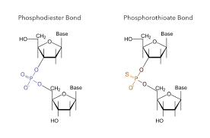

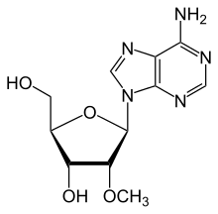
Stability
2′OMe : 2′-O-methyl ribonucleotides

Slide 17
Empirical design parameters determine in-cell performance
Permeabilization is achieved by using streptolysin O, a bacterial (streptococcal) cytolysin that generates large lesions (approximately 15 nm in diameter) in the plasma membrane of cells to allow the efflux of cytosolic proteins.

Slide 18
Strand exchange reactions work in mammalian cells

Slide 19
Strand exchange-based OR and AND logic gates work in mammalian cells

Slide 20
THANK YOU

